Slide 1
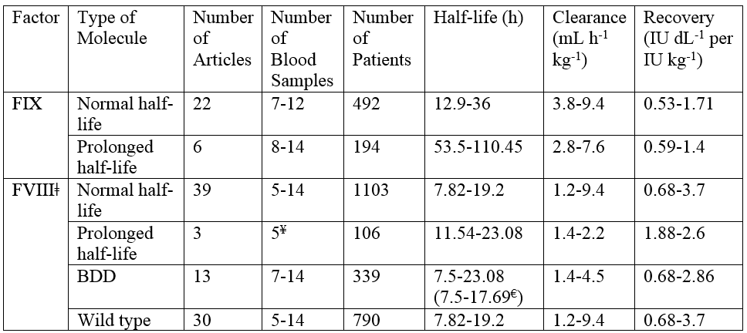
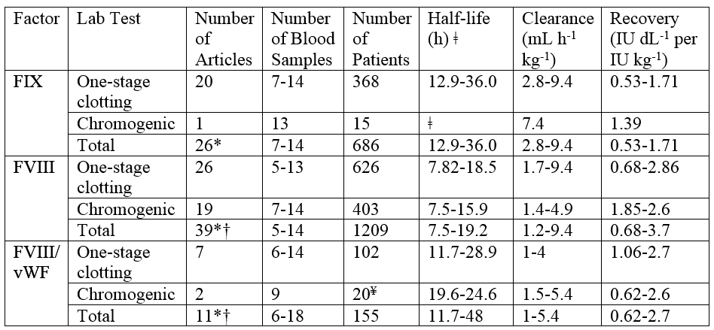
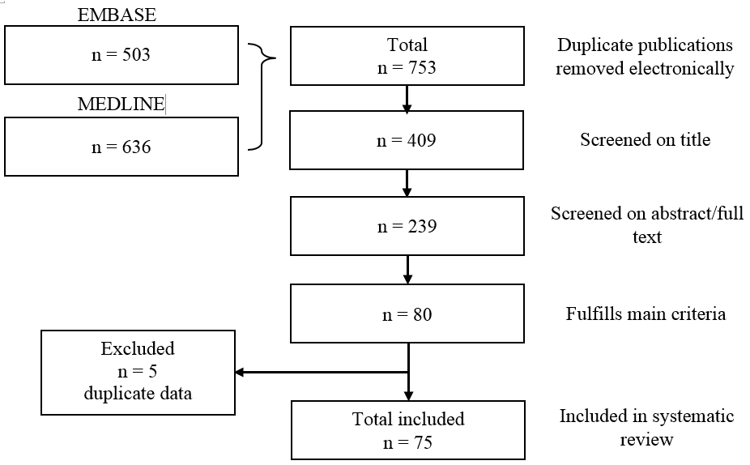
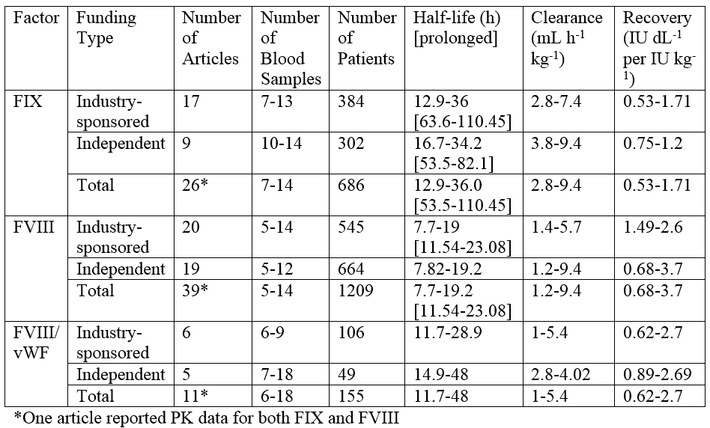
Systematic review of the published evidence on the pharmacokinetic characteristics of factor VIII and IX concentrates
Xi M, Navarro-Ruan T, Mammen S, Blanchette V, Hermans C, Morfini M, Collins P, Fischer K, Neufeld EJ, Young G, Kavakli K, Radossi P, Dunn A, Thabane L and Iorio A
for the WAPPS study group (http://www.clinicaltrials.gov/ct2/show/NCT02061072).
Introduction
Table 1 Summarized pharmacokinetic data grouped by type of FVIII/FIX molecule*†
The efficacy of factor VIII and IX concentrates administered to prevent bleeding episodes in patients with hemophilia A and B is correlated with the plasma levels measured over time after the infusion. The inter-patient variability of pharmacokinetic (PK) parameters is large, and it is difficult to assess individual PK profiles due to the need for multiple blood samples over several hours. This is often not feasible, particularly for pediatric patients. Population PK modeling provides a practical solution to this problem. The successful modelling of PK parameters at the population level requires knowledge of disposal characteristics and relevant covariates. We performed a systematic review of the available evidence in order to identify available PK data for factor VIII and IX concentrates to facilitate the implementation of a population PK approach.
*There were no studies that investigated pharmacokinetics for FVIII/vWF concentrates that had different half-lives or were BDD
†2 FIX articles and 2 FVIII articles reported data on both normal and prolonged half-life; 4 FVIII articles reported data on both wild type and BDD molecules
ǂOne article reported pharmacokinetic data on a FVIII molecule that had a prolonged half-life and was BDD
¥Only one article reported the number of blood samples taken
€If Tiede 2013 is removed
Methods
We conducted a literature search in MEDLINE and EMBASE from January 1997 to May 2014, using the keywords "hemophilia" and "pharmacokinetics". We included only articles that reported original PK data for factor VIII and IX concentrates in humans and were published in English. Two authors independently screened the references and extracted the following data: study design, number of patients, type and severity of hemophilia, patient age, factor concentrate infused, dose infused, sampling data points, half-life, clearance, recovery, the model used for pharmacokinetics, and inclusion of patients undergoing surgery or with inhibitors.
Descriptive statistics have been used for data description.
Results
We retrieved 753 potentially eligible articles published between 1997 and 2014. We included 75 articles meeting our inclusion criteria, with a total of 2050 patients included in PK analyses. Thirty-eight articles reported PK data on factor VIII concentrates, twenty-five articles report PK data on factor IX concentrates, and one article reported on both factor VIII and IX concentrates. Eleven articles reported pharmacokinetic data on both factor VIII and Von Willebrand factor concentrates.
Main PK parameters and their variability where summarized by class of concentrate, laboratory test technique used, sponsor of the trial, modeling characteristics as well as candidate relevant covariates.
Table 2 Summarized pharmacokinetic data grouped by laboratory test
*7 FIX articles, 5 FVIII, and 3 FVIII/vWF articles did not report lab test; one article reported PK data for both FIX and FVIII
†12 articles reported FVIII PK data and 1 article reported FVIII/vWF PK data for both one-stage clotting and chromogenic assays
ǂLong-acting FIX half-life was not included in this table
¥Only one of the articles reported the number of patients included in the study
Conclusions
This review provides the first systematic appraisal of the methods and results of published papers in the field.
The data gathered confirms the large intra-patient variability of factor concentrate PK and provides useful information on which to build population based PK models.
“The broader picture”
Figure 1. Study search and selection.
Mounting evidence points to the value of using individual pharmacokinetic (PK) estimates to tailor substitution treatment regimens to the need of the patient
Estimating individual PK parameters with a classical approach requires 9-11 samples drawn after a single infusion of factor concentrate
Modelling PK parameters at the population level requires sophisticated bayesian statistics, but allows reliable estimates based on 2-4 samples after one or more infusions
Recently, our group has been granted peer-reviewed funds to develop a web-based population PK service (WAPPS)
As a first step in the project, we have performed a systematic review of the published evidence to locate the data needed to develop robust population PK models to inform our system
Table 3 Summarized pharmacokinetic data grouped by type of funding
*One article reported PK data for both FIX and FVIII
Download at hemophilia.mcmaster.ca

